Slide 1
Sales Performance Analysis and Recommendations
Uncovering Insights to Drive Growth

Slide 2
Group 3 SQL Project
Ojedokun Olutimileyin Victoria
Olukiran Christian Olamide
Ojo Iyanu
Wale

Slide 3

Introduction
This project is a sales performance analysis aimed at uncovering key insights and providing actionable recommendations to drive business growth.
By analyzing various aspects of sales data, including product performance, customer behavior, and revenue trends, we can identify areas for improvement and opportunities for expansion.

Slide 4


Objectives
This analysis aims to understand key sales trends, customer behavior, and product performance to identify opportunities for growth and optimization
This is a transactional data set which contains all the transactions occurring between 01/12/2010 and 09/12/2011 for a UK-based and registered non-store online retail.The company mainly sells unique all-occasion gifts. Many customers of the company are wholesalers.

Slide 5
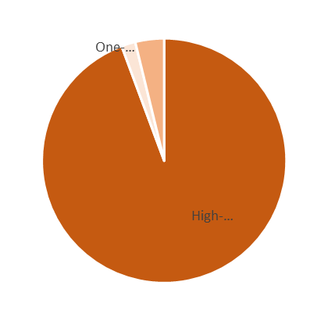
Customer Segmentation
High-Frequency Buyers contribute the most to overall revenue, emphasizing the importance of retention strategies.
One-time Buyers represent a significant untapped opportunity for future sales.

Slide 6
Top 10 Best-Selling Products
United Kingdom Dominance: All of the top 10 best-selling products were primarily sold in the United Kingdom, emphasizing its importance as the core market.
Product Popularity: The data highlights the popularity of specific product categories, such as decorative items (ornaments, hanging lights), giftware (purses, bags), and party supplies (cake cases, popcorn holders).
Product Lifecycle: Analyzing the sales trends of these products can help identify their lifecycle stages and inform inventory management and marketing strategies.

Slide 7

The United Kingdom stands out as the largest market, contributing significantly to overall revenue.
Other European countries like Germany, France, Ireland, and the Netherlands also contribute substantially.
Revenue by Country

Slide 8
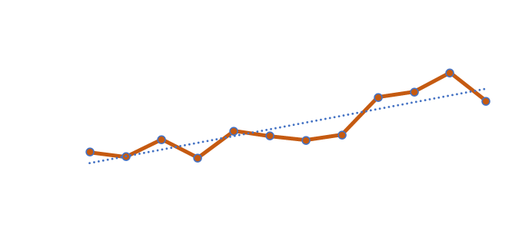
Monthly Sales Performance
The chart reveals distinct seasonal patterns in sales, with fluctuations throughout the year.
The analysis provides insights into how demand fluctuates throughout the year due to seasonal factors
This information can be used to adjust inventory levels accordingly, ensuring that there is sufficient stock during peak periods and avoiding excess inventory during off-peak times.

Slide 9
Customer ID 14646: This customer has placed the most orders (2085) and generated significant revenue. However, their average order value is relatively low, indicating that they might be more price-sensitive.
Customer ID 18102 and 17450: These customers have placed fewer orders but have higher average order values, suggesting they are high-value customers who might be willing to spend more on premium products.
Customer ID 14911: This customer has placed a large number of orders (5903) but has a very low average order value. This could indicate that they primarily purchase low-value items or are more price-sensitive.
Customer Lifetime Value (CLV) Analysis

Slide 10
Product Performance Analysis
Category A: Sales for Category A experienced a substantial growth in 2011 compared to 2010. This growth was consistent across all quarters of 2011.
Category B: Category Balso showed a positive trend in 2011. The quarterly sales figures steadily increased throughout the year.
Other: This category exhibited the most pronounced growth in 2011. The quarterly revenue figures for Other in 2011 were significantly higher than those in 2010.

Slide 11
Conclusion
The company has demonstrated strong sales performance, particularly in the United Kingdom market. However, there are opportunities to optimize inventory management, improve customer retention, and expand into new markets.

Slide 12
Recommendation
Inventory Management:
Implement robust inventory management systems to optimize stock levels and minimize stockouts and overstocks.
Customer Relationship Management:
Prioritize customer retention by implementing loyalty programs and personalized marketing campaigns.
Market Expansion:
Explore opportunities to expand into new markets, particularly in Europe.
Conduct market research to identify potential markets and tailor marketing strategies accordingly.

Slide 13
Comments
Feedbacks
Questions

Slide 14



